Slide 1
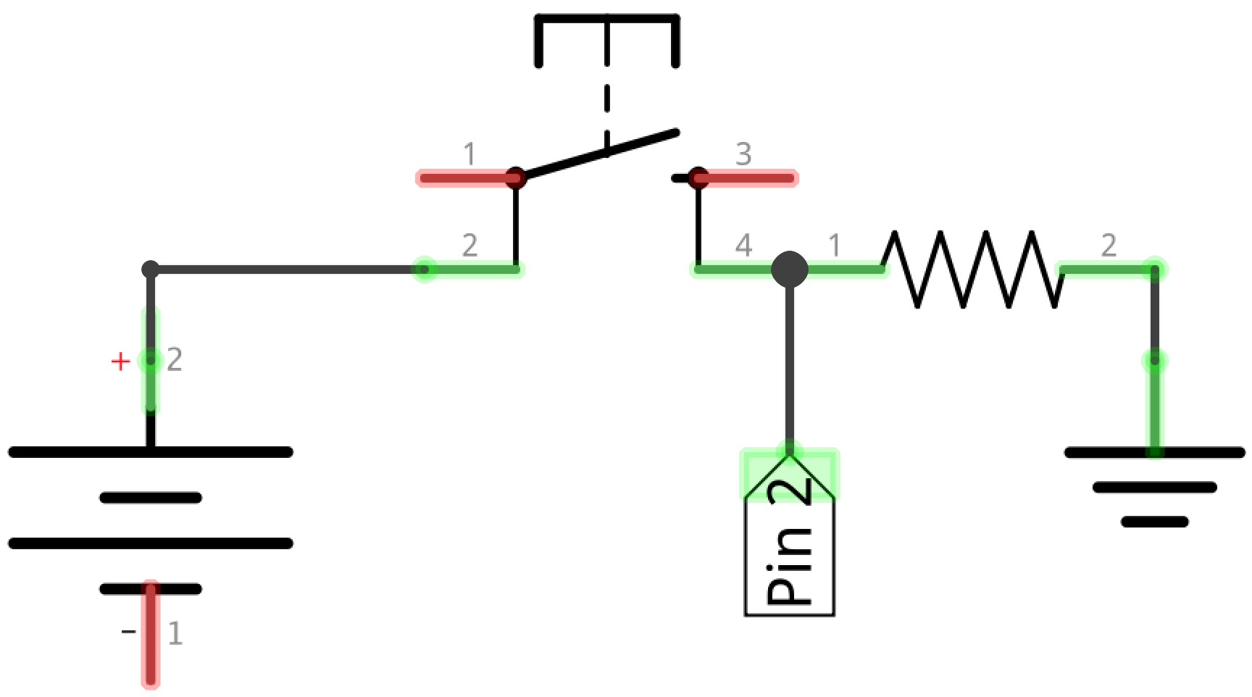

Slide 2
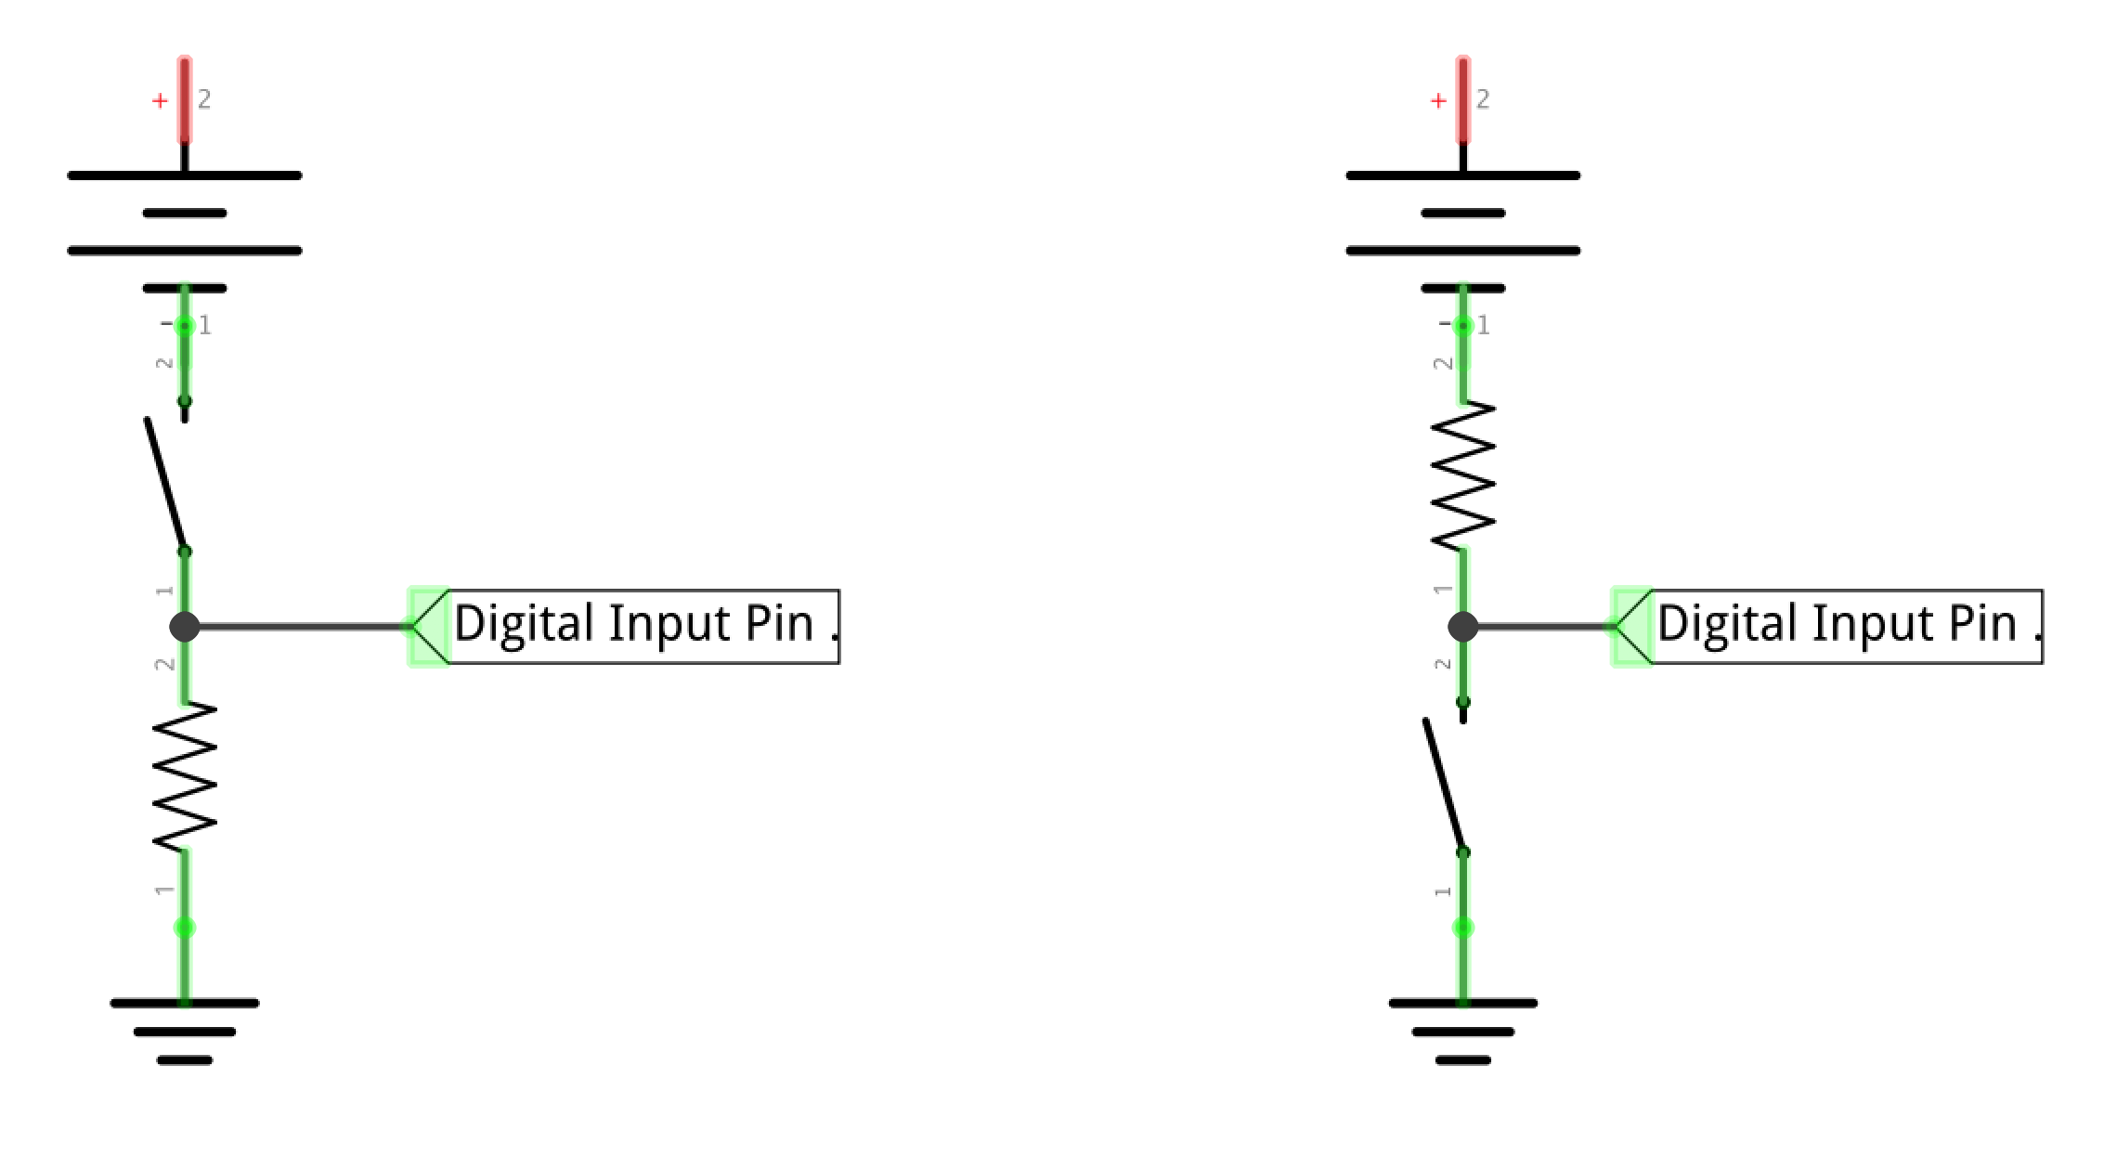

Slide 4
+5V
V_{pin} = 0V
GND

Slide 5
+5V
V_{pin} = 0V
V_{pin} = 5V
GND

Slide 6
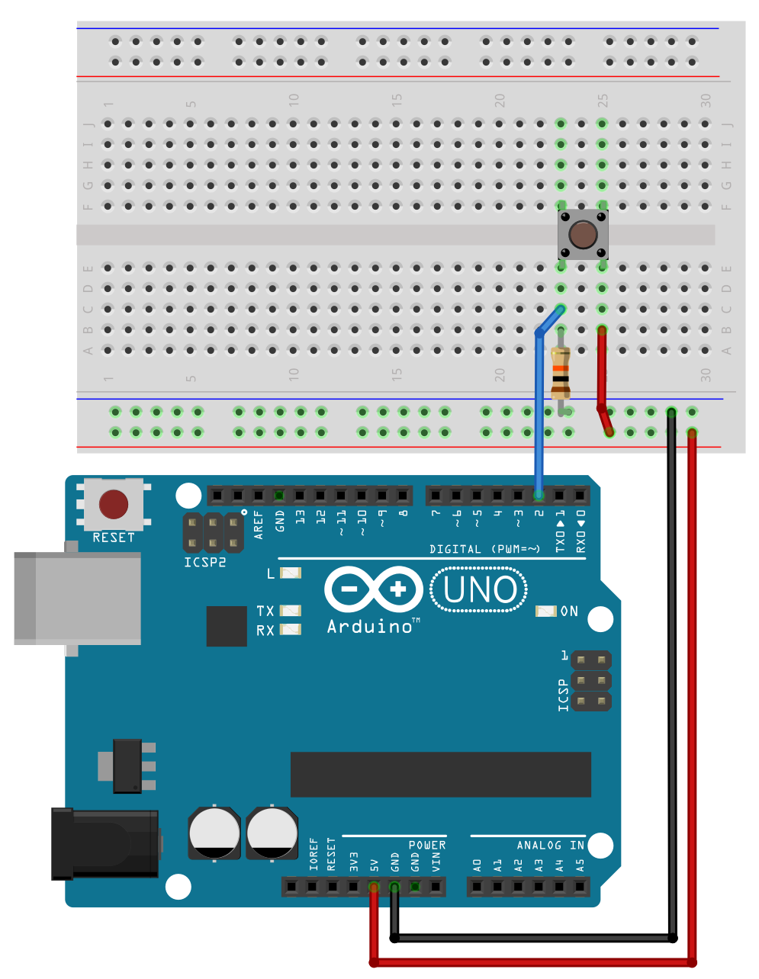
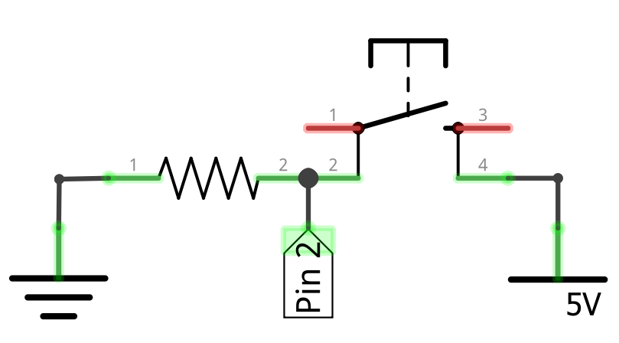
Pull-down Resistor Configuration
Push Button (4-Leg)
10KΩ
5V
GND
Vcc
Notes:
Pull-down resistor configuration

Slide 7
Pull-down Resistor Configuration
Push Button (4-Leg)
10KΩ
5V
GND
Vcc
Notes:
Pull-down resistor configuration

Slide 8
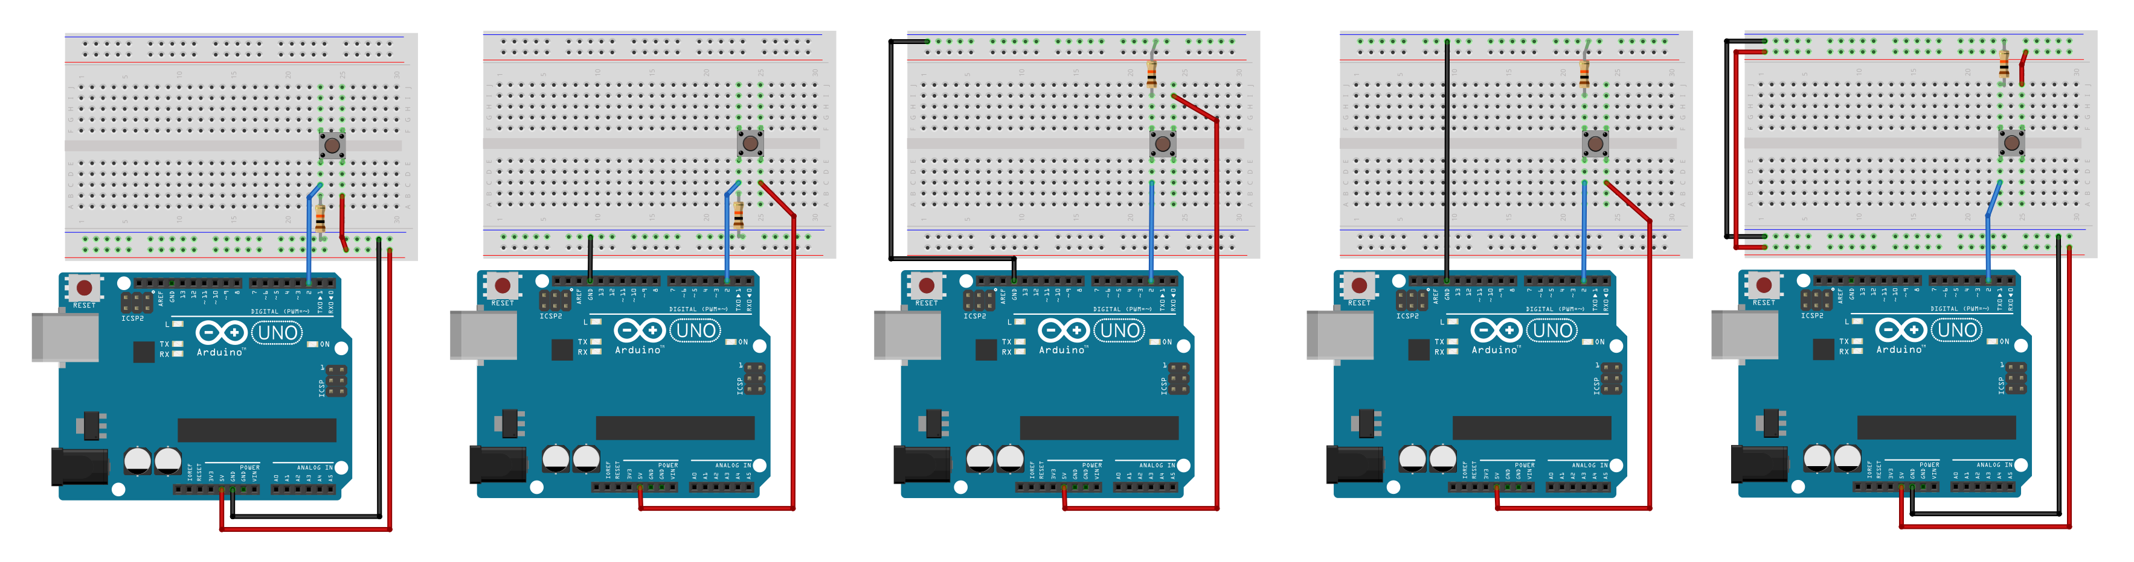
Notes:
Various configurations of pull-down (and functionally correct)

Slide 9
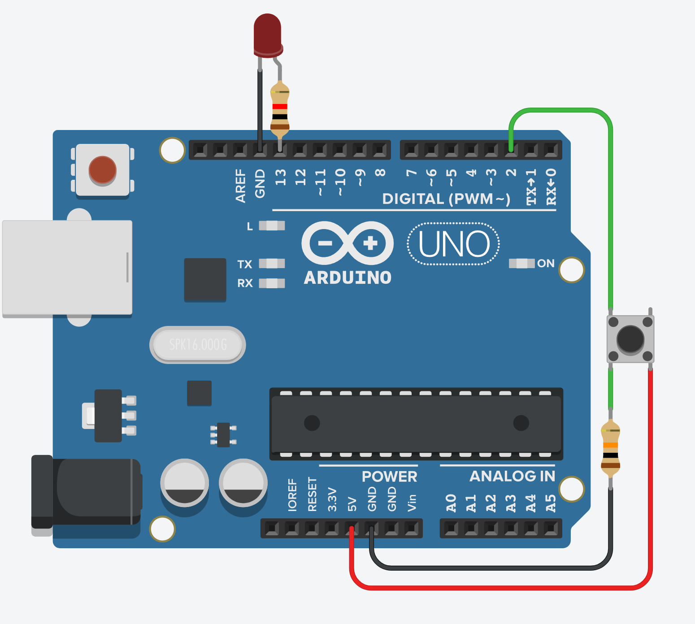
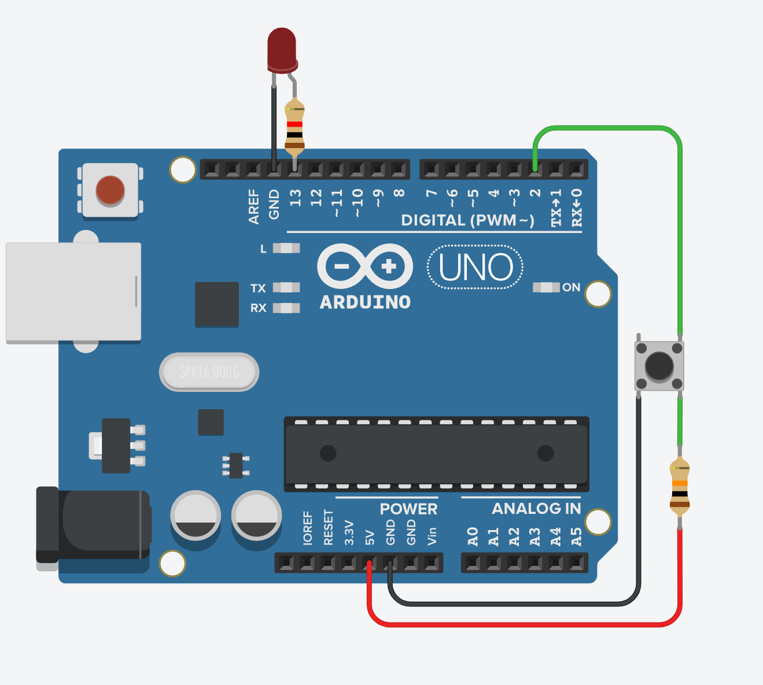
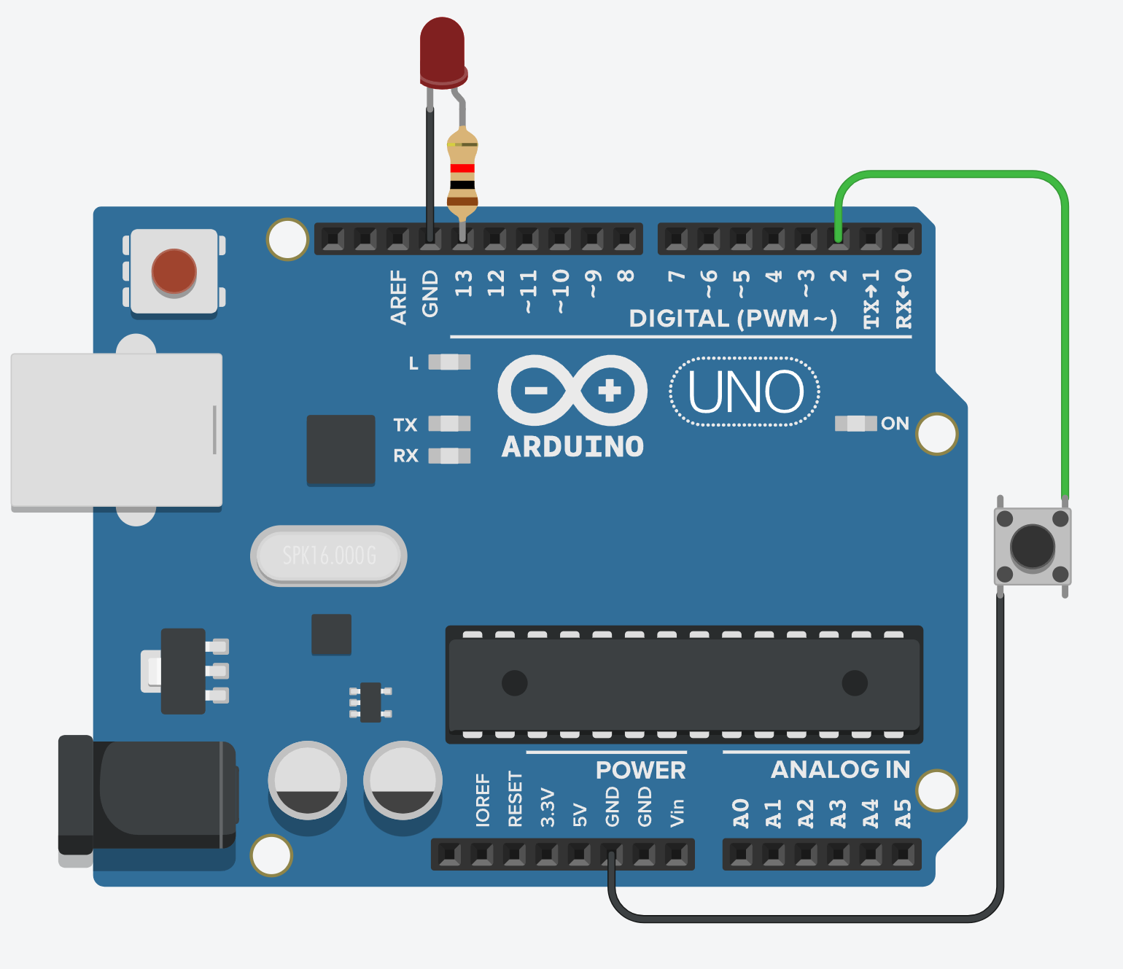
Pull-down Resistor
Pull-Up Resistor
Internal Pull-Up Resistor

Slide 10
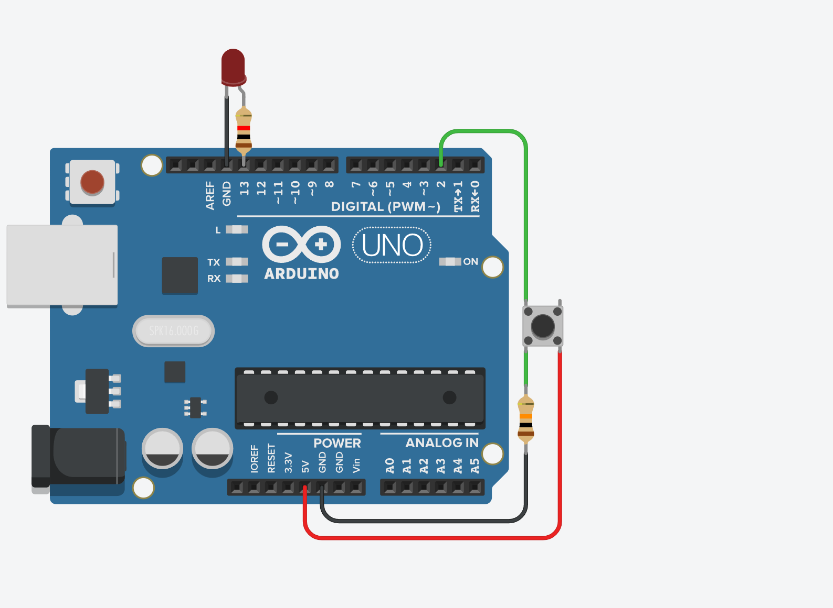
External
Pull-down
Resistor
Configuration
Notes:
https://www.tinkercad.com/things/hlkxqsvSz2E-button-with-pull-down-resistor-no-breadboard

Slide 11
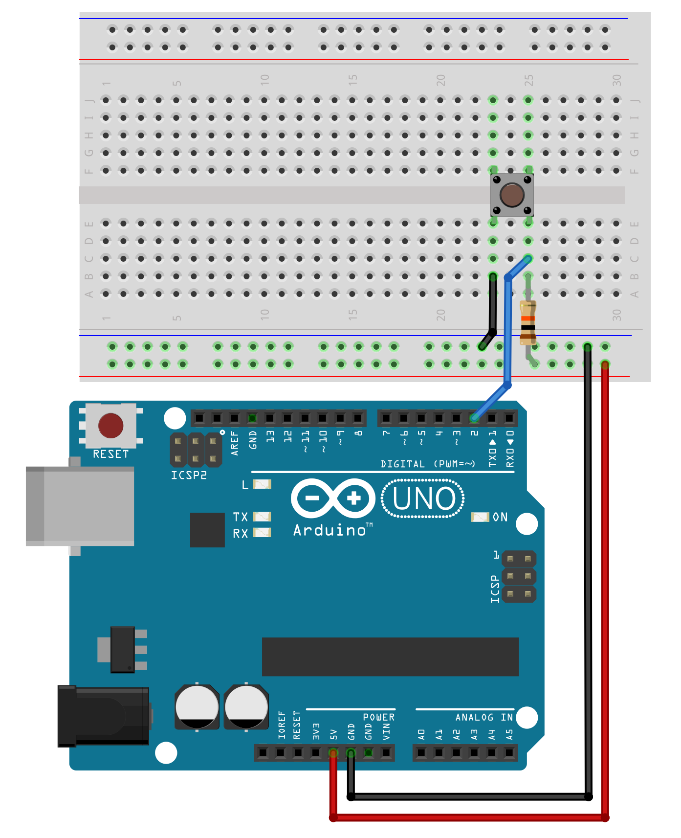
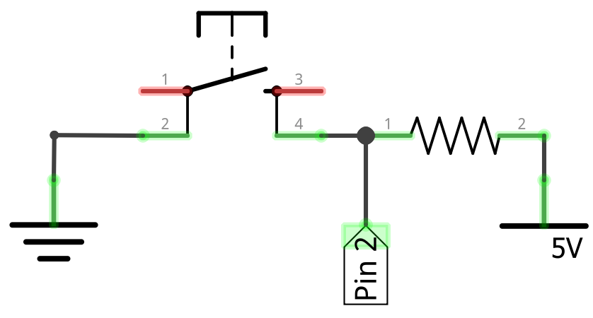
Pull-Up Resistor Configuration
Push Button (4-Leg)
10KΩ
GND
5V
Vcc

Slide 12
External
Pull-Up
Resistor
Configuration

Slide 13
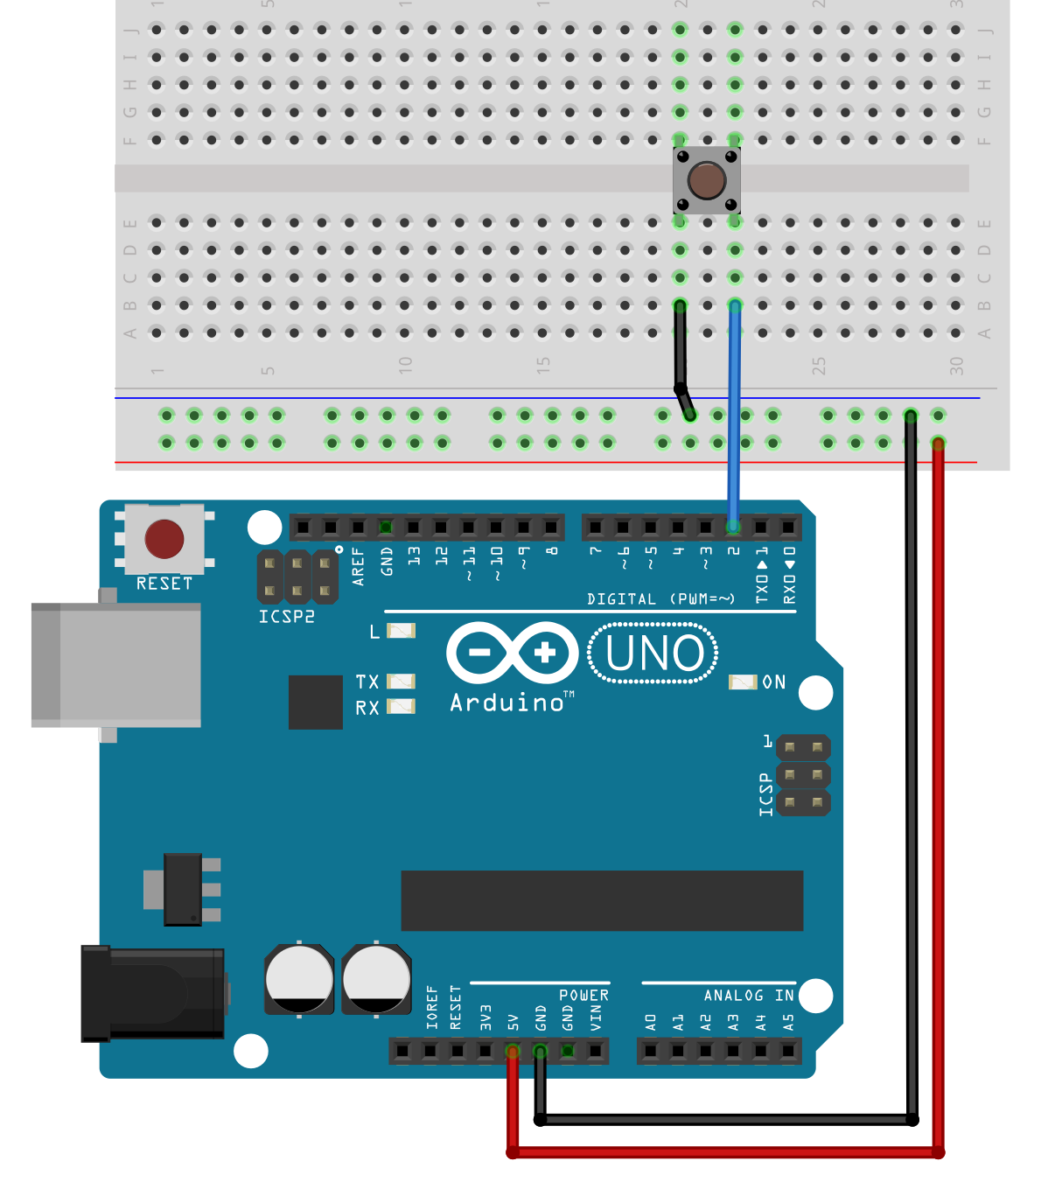
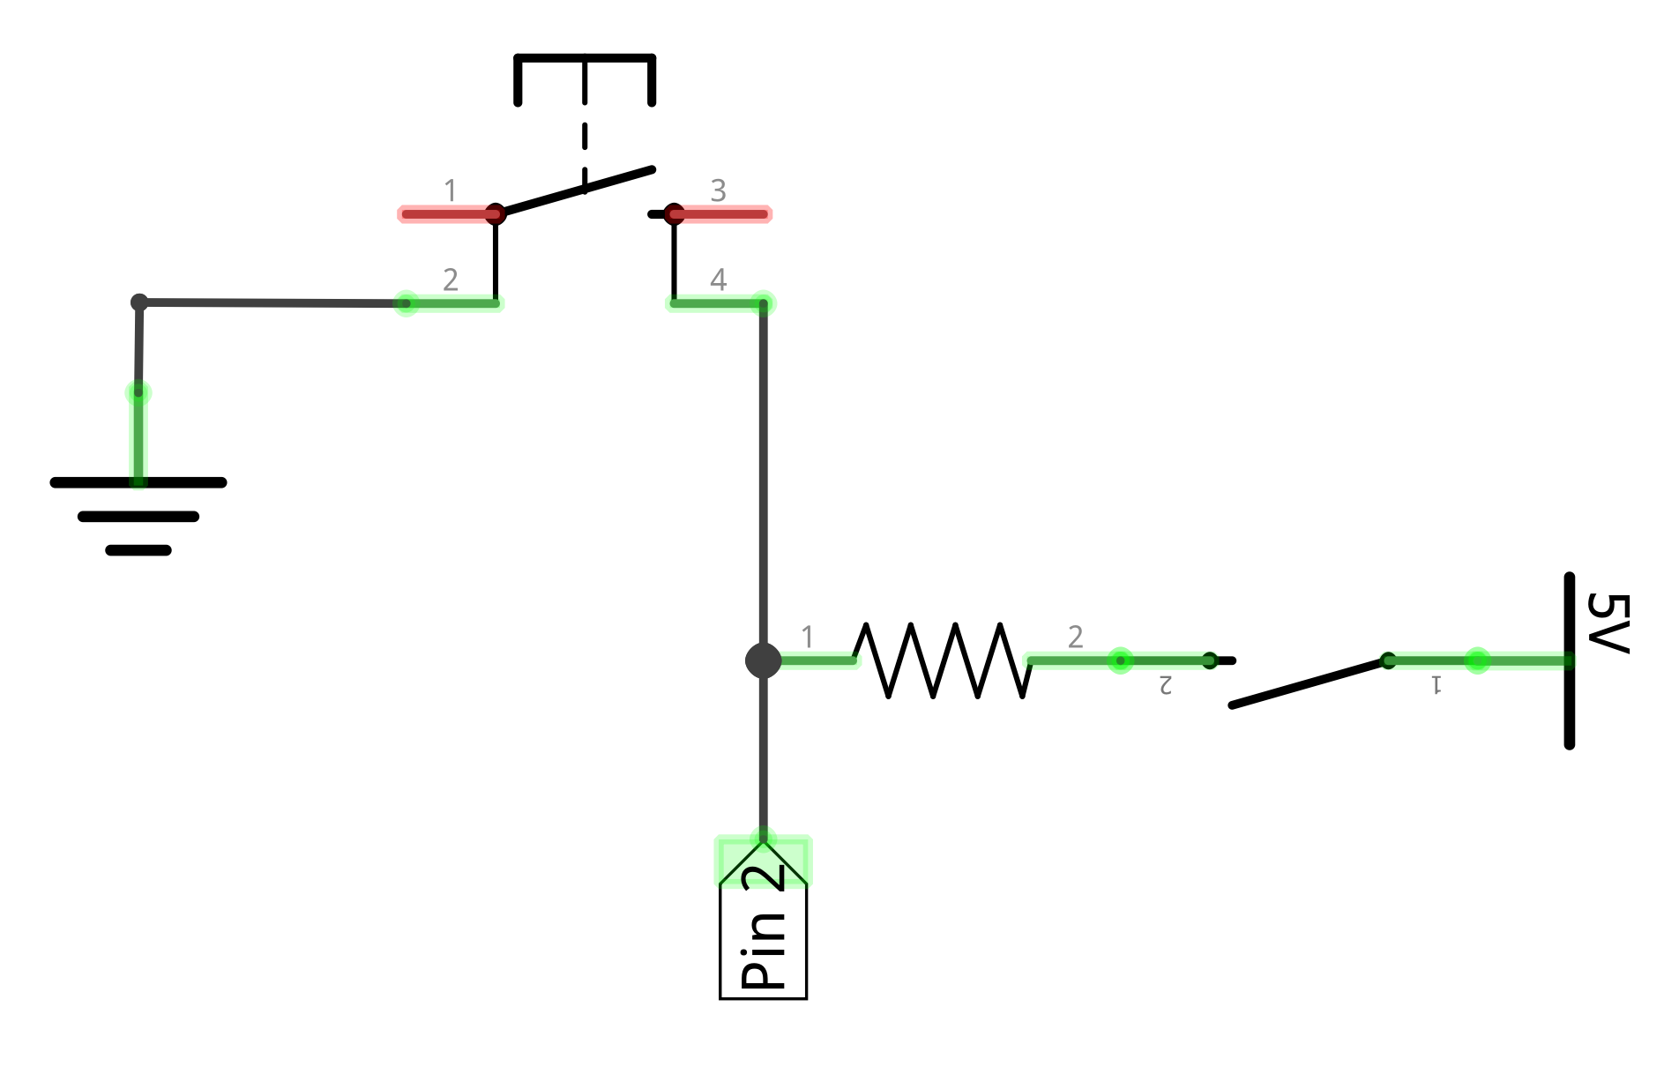
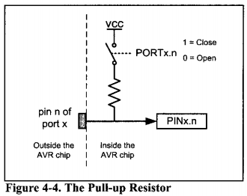
Internal Pull-up Resistor Configuration
Push Button (4-Leg)
Pin 2
Outside Microcontroller
GND
Inside Microcontroller
20KΩ
Software controlled switch enabled by INPUT_PULLUP
Notes:
Based on https://electronics.stackexchange.com/q/185953

Slide 14
Internal
Pull-Up
Resistor
Configuration

Slide 15
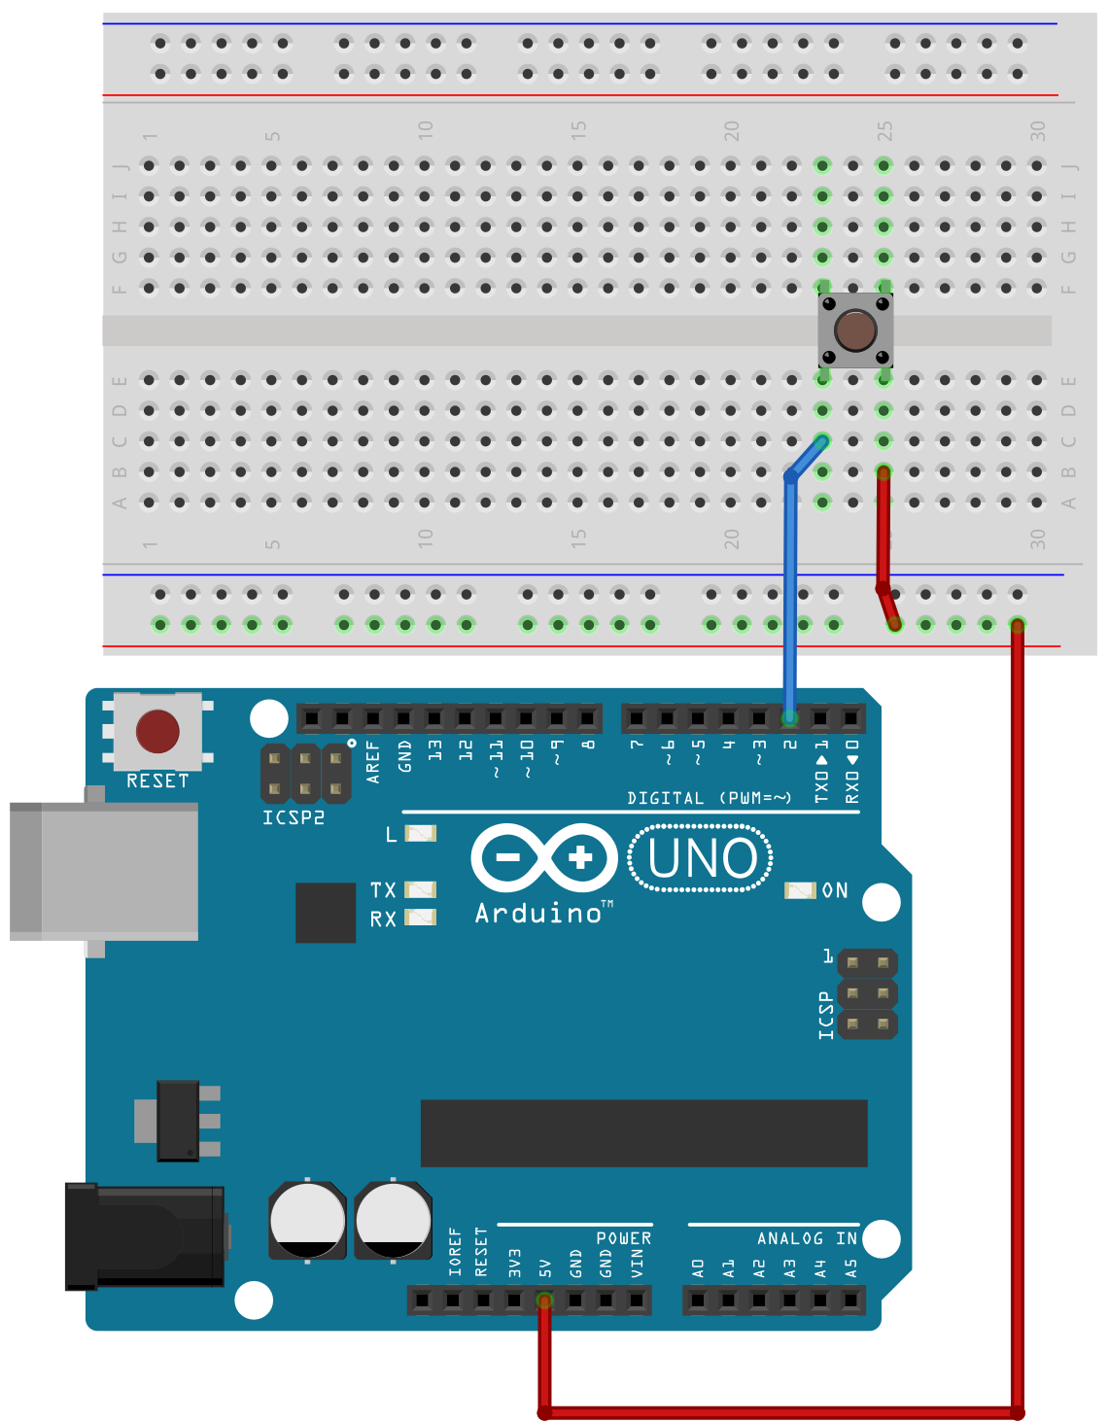
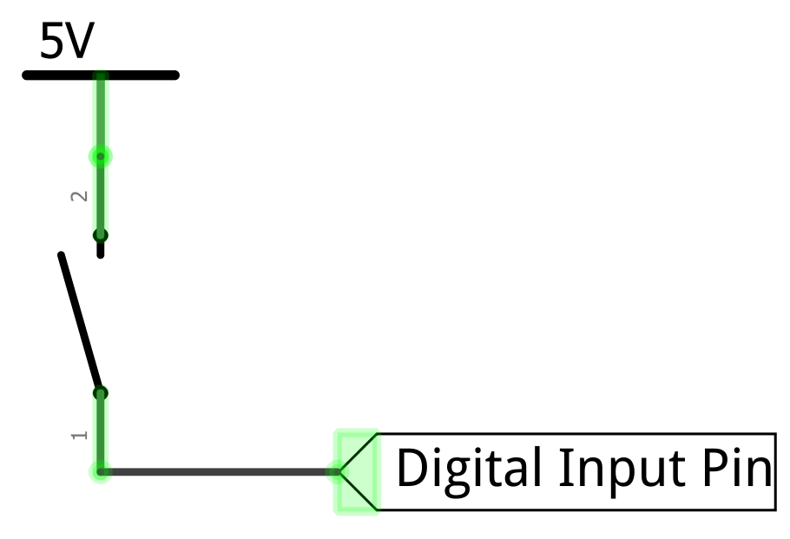

Slide 16
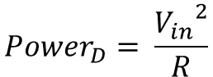
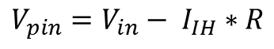
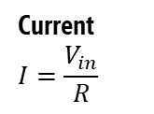
Selecting a pull-up resistor value
On the ATmega328, V_{pin} needs to be > 3V to qualify as HIGH and < 1.5V to qualify as LOW. The in-between voltage range (1.5V-3V) is undefined.
Switch open, input HIGH
Switch closed, input LOW
V_{in}
V_{in}
Input leakage current I_{IH} = ~1µA
Microcontroller
Microcontroller
R=10KΩ
R=10KΩ
Current $$I=\frac{V_{in}}{R}$$
V_{pin}
V_{pin}
Input Pin
Input Pin
GND
GND
$$V_{pin}=V_{in}− I_{IH}∗R$$
$${Power}_{D}= \frac{{V_{in}}^{2}}{R}$$

Slide 18
V_{pin} = 4.99V

Slide 19
Switch Closed: Input Pin Voltage and Power Dissipation as a Function of Pull-Up Resistor R
Input Pin Voltage and Power Dissipation as a Function of Pull-Up Resistor R when switch closed
V_{pin} LOW threshold

Slide 20
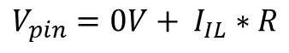
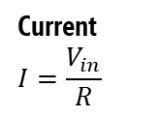
Selecting a pull-down resistor value
On the ATmega328, V_{pin} needs to be > 3V to qualify as HIGH and < 1.5V to qualify as LOW. The in-between voltage range (1.5V-3V) is undefined.
Switch open, input LOW
Switch closed, input HIGH
V_{in}
V_{in}
Microcontroller
Microcontroller
Input Pin
V_{pin}
Current $$I=\frac{V_{in}}{R}$$
Input Pin
V_{pin}
R=10KΩ
Output leakage current I_{IL} = ~1µA
R=10KΩ
GND
GND
$$V_{pin}=0V+ I_{IL}∗R$$
$${Power}_{D}= \frac{{V_{in}}^{2}}{R}$$

Slide 21

Open

Slide 22
Open

Slide 23
Button pressed!
The input pin is now 5V
digitalRead(2)returns HIGH
Closed

Slide 24
Button not pressed!
But what does the input pin read when the button is not pressed?
The pin can oscillate between HIGH and LOW. This is called a floating pin!
Open

Slide 25
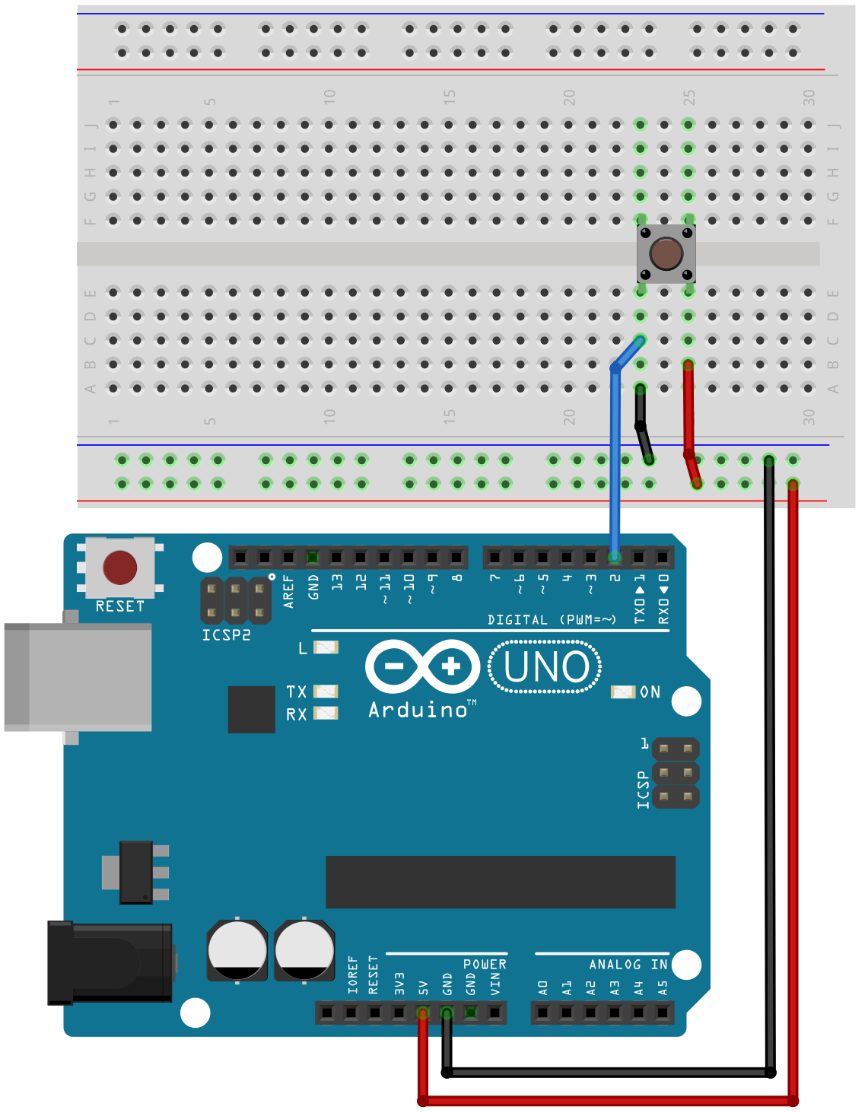
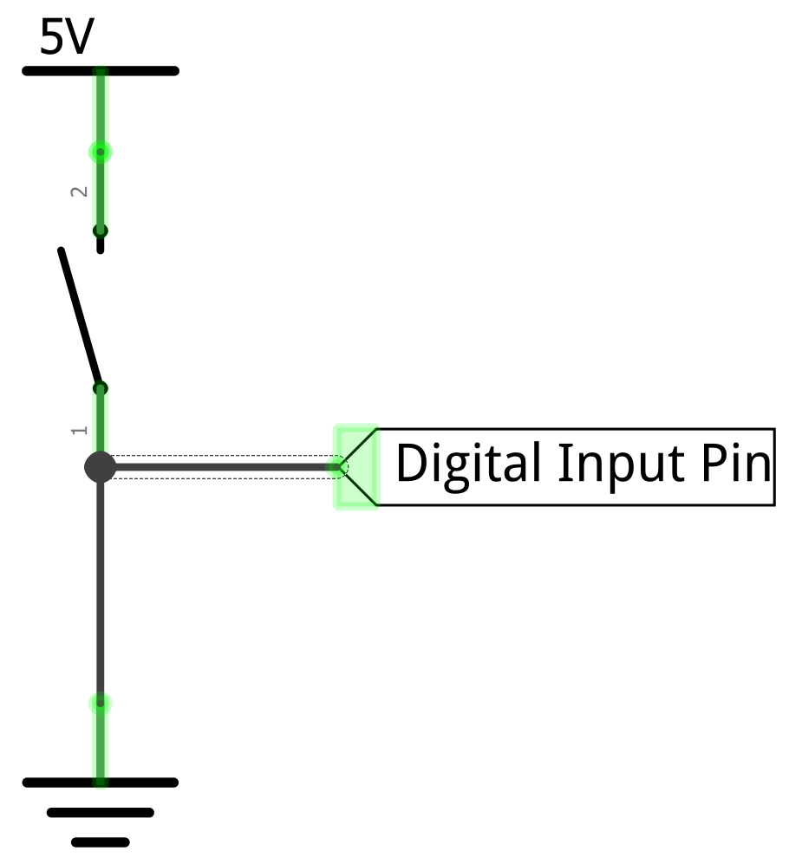
To solve the floating pin problem, you might think to add a GND connection
Open

Slide 26
To solve the floating pin problem, you might think to add a GND connection
Added GND wire
Open
Add GND here

Slide 27
To solve the floating pin problem, you might think to add a GND connection
Button not pressed!
Open
Now, with the switch open, the input pin is 0V rather than floating
So, digitalRead(2)returns LOW

Slide 28
Now, with the switch open, the input pin is 0V rather than floating
So, digitalRead(2)returns LOW
Button not pressed!
Open

Slide 29
However… now what happens when we press the button?
Button not pressed!
Open

Slide 30
However… now what happens when we press the button?
Button not pressed!
Open

Slide 31

A short circuit!
This can damage our microcontroller
Button pressed!
Closed

Slide 32
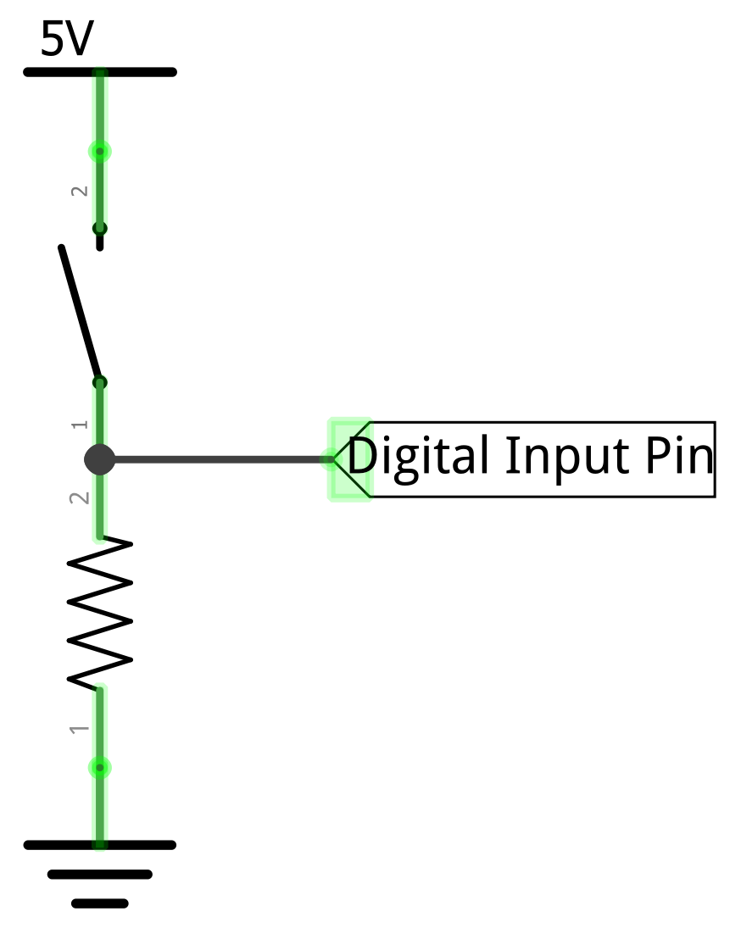
So, we add a pull-down resistor

Slide 33
So, we add a pull-down resistor
Added pull-down resistor
This resistor “pulls down” the digital input pin to GND when the switch is open

Slide 34
Now, with the switch open, the input pin is pulled down to 0V
So, digitalRead(2)returns LOW
Button not pressed!
Open

Slide 35
And with the switch closed, the input pin becomes 5V, and the pull-down resistor prevents a short circuit
So, digitalRead(2)returns HIGH
Button pressed!
Closed

